Slide 1
Personality Prediction Through CV
Created by,
Name : Sri Balaji.C
Reg. No. : 912321104040
Class : III ^{rd} year CSE
College : SACS M.A.V.M.M. Egineering college
Place : Madurai

Slide 2
Project outline:
Problem statement
Proposed system/solution
System development approach
Alogrithom and deployment
Result
conclusion

Slide 3
Problem Statement:
Develop a system to predict personality traits based on an individual's CV (resume), using natural language processing and machine learning techniques. The system should analyze text data from the CV to infer characteristics such as extroversion, conscientiousness, openness, agreeableness, and neuroticism, aiding in recruitment processes and career counseling.

Slide 4
Proposed solution:
The system built in this project predicts personality of peoples by using their gender, age, score of openness, conscientiousness, extraversion, agreeableness, neuroticism and experience.
It parses all the data from CV/resume and on the result page, it shows all the information from the entered data and uploaded resume.
This system uses logistic regression for training the model and pyresparser module for parsing the information from resume which is built using nltk and spaCy module in python.

Slide 5
System Development Approach:
Hardware Requirements:
Processing Unit:
Utilize a high-performance CPU or GPU for training and inference tasks. GPUs are preferred due to their parallel processing capabilities, which significantly speed up training times .
RAM:
Sufficient RAM is necessary to handle large datasets and model parameters. The amount of RAM required depends on the size of the dataset and the complexity architecture.

Slide 6
Hardware Requirements(cont…)
Storage:
You'll need storage space for storing datasets, trained models, and intermediate results. Consider using SSDs for faster data access and model loading times.
Network:
A robust network infrastructure with high-speed internet connectivity is essential for seamless data transmission and model training in the AI project.
It should support scalable architecture to accommodate expanding data and computational needs. Security measures must be in place to safeguard sensitive data and prevent unauthorized access.

Slide 7
Software Requirements:
Python Modules/Libraries:
1. OS: For accessing the files and data from internal storage.
2. Pandas: For accessing and manipulating datasheets.
3. Numpy: For working on arrays and other data manipulation.
4. Tkinter: For building the GUI.
5. Functools: Tools for Manipulating Functions. Purpose: Functions that operate on other functions.
6. Pyresparser: Module for extracting information from resume.
7. Sklearn: It features various classification, regression and clustering algorithms. We used sklearn to make the model learn on various characteristic values using logical regression.

Slide 8
Algorithm and deployment:
Problem Statement:
Develop an AI-based system to predict personality traits from CVs (resumes) to assist recruiters in evaluating job applicants more effectively.
Input Method:
Use Natural Language Processing (NLP) techniques to data to remove noise, irrelevant information, and standardize the format.
Collect CVs/resumes from job applicants in digital format.
Extract textual information from CVs using Optical Character Recognition (OCR) or document parsing techniques.
Preprocess the text analyze the textual content of the CVs.
Extract relevant features such as language style, keywords, employment history, education background, skills, achievements, and interests.

Slide 9
Outcome:
Predicted personality traits for each job applicant, which may include:
Extroversion vs. Introversion
Openness to Experience
Conscientiousness
Agreeableness
Emotional Stability These predictions can be presented as scores or labels indicating the likelihood or degree of each personality trait.

Slide 10
Algorithm steps:
Data Collection:
Gather CVs of individuals.
Extract relevant information such as education background, work experience, skills, hobbies, interests, and any other pertinent details that might indicate personality traits.
Feature Extraction:
Identify key features from the CV that are indicative of personality traits.
For example, language used, job titles, duration of employment, level of education, extracurricular activities, etc.
Mapping to Personality Traits:
Utilize a predefined framework or model for mapping CV features to personality traits.
Common frameworks include the Big Five personality traits (Openness, Conscientiousness, Extraversion, Agreeableness, and Neuroticism).
Design algorithms or rules to assign scores or labels to each trait based on the extracted features.

Slide 11
Algorithm steps (cont…)
Model Training and Validation:
Use the collected CV data with annotated personality traits to train a machine learning model.
Employ techniques such as regression, classification, or clustering depending on the nature of the problem.
Validate the model using techniques like cross-validation to ensure its accuracy and generalizability.
Prediction:
Apply the trained model to new CVs to predict personality traits.
Evaluate the predictions and refine the model if necessary based on feedback and performance metrics.
Provide insights or recommendations based on predicted personality traits, such as suitability for a particular role or team dynamics.

Slide 12
Deployment steps:
The Big Five Personality Traits Model measures five key dimensions of people's personalities:
Openness:
sometimes called "Intellect" or "Imagination," this measures your level of creativity, and your desire for knowledge and new experiences.
Conscientiousness:
This looks at the level of care that you take in your life and work. If you score highly in conscientiousness, you'll likely be organized and thorough, and know how to make plans and follow them through. If you score low, you'll likely be lax and disorganized.

Slide 13
Deployment steps(cont...)
Extraversion/Introversion:
This dimension measures your level of sociability. Are you outgoing or quiet, for instance? Do you draw energy from a crowd, or do you find it difficult to work and communicate with other people?
Agreeableness:
This dimension measures how well you get on with other people. Are you considerate, helpful and willing to compromise? Or do you tend to put your needs before others'?
Natural Reactions:
Sometimes called "Emotional Stability" or "Neuroticism," this measure emotional reactions. Do you react negatively or calmly to bad news? Do you worry obsessively about small details, or are you relaxed in stressful situations?

Slide 14
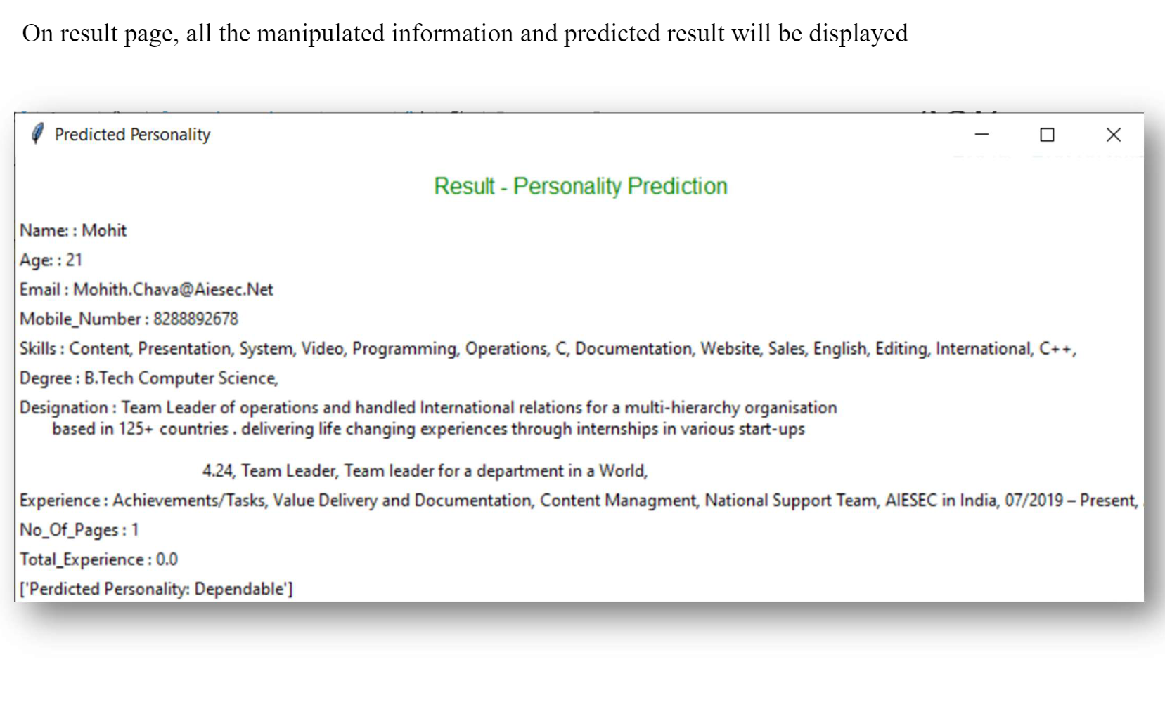
Result:

Slide 15
References:
https://www.tensorflow.org/
https://numpy.org/
https://scikit-learn.org/stable/
https://keras.io/
https://matplotlib.org/
https://github.com/sribalaji1122/TNSDC-Generative-AI.git
https://github.com/sribalaji1122/TNSDC-Generative-AI/blob/main/training_dataset.csv
https://colab.research.google.com/

Slide 16
Conclusion:
In conclusion, the application of machine learning algorithms for personality prediction through CV analysis presents promising potential in various domains, including recruitment, personalized marketing, and mental health assessment. Despite its efficacy in extracting valuable insights from textual data, the reliability and ethical implications of such predictions warrant careful consideration. Continued research efforts focused on refining models, addressing biases, and ensuring transparency in decision-making processes are crucial for maximizing the benefits of this technology while minimizing its potential drawbacks.

